Slide 1

Session 7
Expect the Unexpected – Curiosity,
Reflection, and Creativity in Libraries
Dianne Cmor and Jeff Trzeciak

Slide 2
Expect the Unexpected: Engaging your community in new ways
Jeffrey Trzeciak
HKUL Leadership Institute 2018
Hong Kong

Slide 3
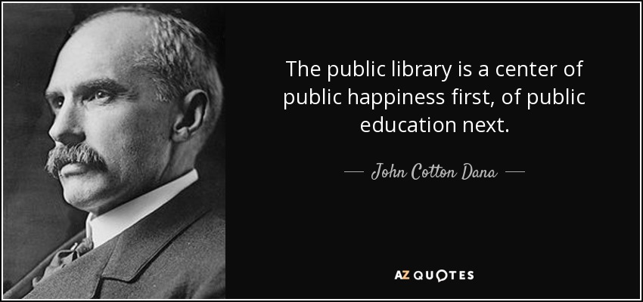
History of innovative programming
Notes:
Long standing history of innovation including first business library in the US, open stacks and first foreign language collections for immigrant communities

Slide 4

Expect the Unexpected: Building on our strengths
Open Stacks
First chidren’s literature collection
First foreign language collections and services to immigrant communities
First business library
Newark Museum
Started the Special Libraries Association
Notes:
The Museum was exceptional because it included contemporary American commercial products as folk art as well as factory-made products. John C. Dana personally believed that purchasing European oil painting was a waste of money and thus supported American art movements. He did not like modern art, but he believed in the principle of a universal museum and thus ordered purchases of art associated with the Ashcan School. In 1915, he curated the exhibition "Clay Products of New Jersey" where he displayed two porcelain toilets from Trenton Potteries, part of his work toward including industrial arts in the museum.^{[6]} Cotton also began the Newark Museum's notable Tibetan collection.

Slide 5
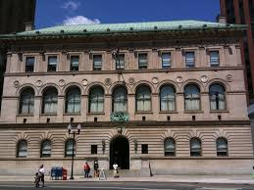
Reputation continues…
Newark Public Library today…
  Only Spanish-language reading room in the State.
  The only Puerto Rican archivist in the State.
  The only Puerto Rican archive in the State.

Slide 6
Engaging Community
Strategic Planning – DJA Consulting
  7 public forums held across the city
  Online survey (English, Spanish, Portuguese)
  More than 80% of the staff responded to requests for input

Slide 7
Engaging community: What we learned
They are proud of its history and excited about the future.
There is a strong community culture and sense of pride.
Participants find Newark to be welcoming and friendly, a place with lots to do. It is a city that is evolving.
The diversity of the community is appreciated.
People love their neighbors and their neighborhoods and want to build an even stronger sense of community.

Slide 8
Engaging community: What we learned
There is a desire to recognize and celebrate local culture and history.
NPL has the strategic opportunity to be a leader in the community’s health and well-being, and in preserving and celebrating its past, present and future.

Slide 9
Engaging community: What we learned
There is a desire to recognize and celebrate local culture and history.
NPL has the strategic opportunity to be a leader in the community’s health and well-being, and in preserving and celebrating its past, present and future.

Slide 10
Engaging community: What we learned
It is perceived as a safe space.
The unique collections and exhibitions are valued by library patrons.
Existing services, programs and promotion are sometimes more library-oriented rather than community-oriented.
Additional programming is desired, but simply offering more activities is not enough;

Slide 11
Engaging community: What we learned
The Library must also consider its outreach, marketing and promotional initiatives to increase its overall visibility in a time when some see libraries as unnecessary.
Collaboration and partnership with other city entities, community services, educational and cultural institutions can make NPL a vital resource for Newark’s future.
NPL has the strategic opportunity to develop new strengths that more closely align with the community’s needs and deliver a measurable impact.

Slide 12
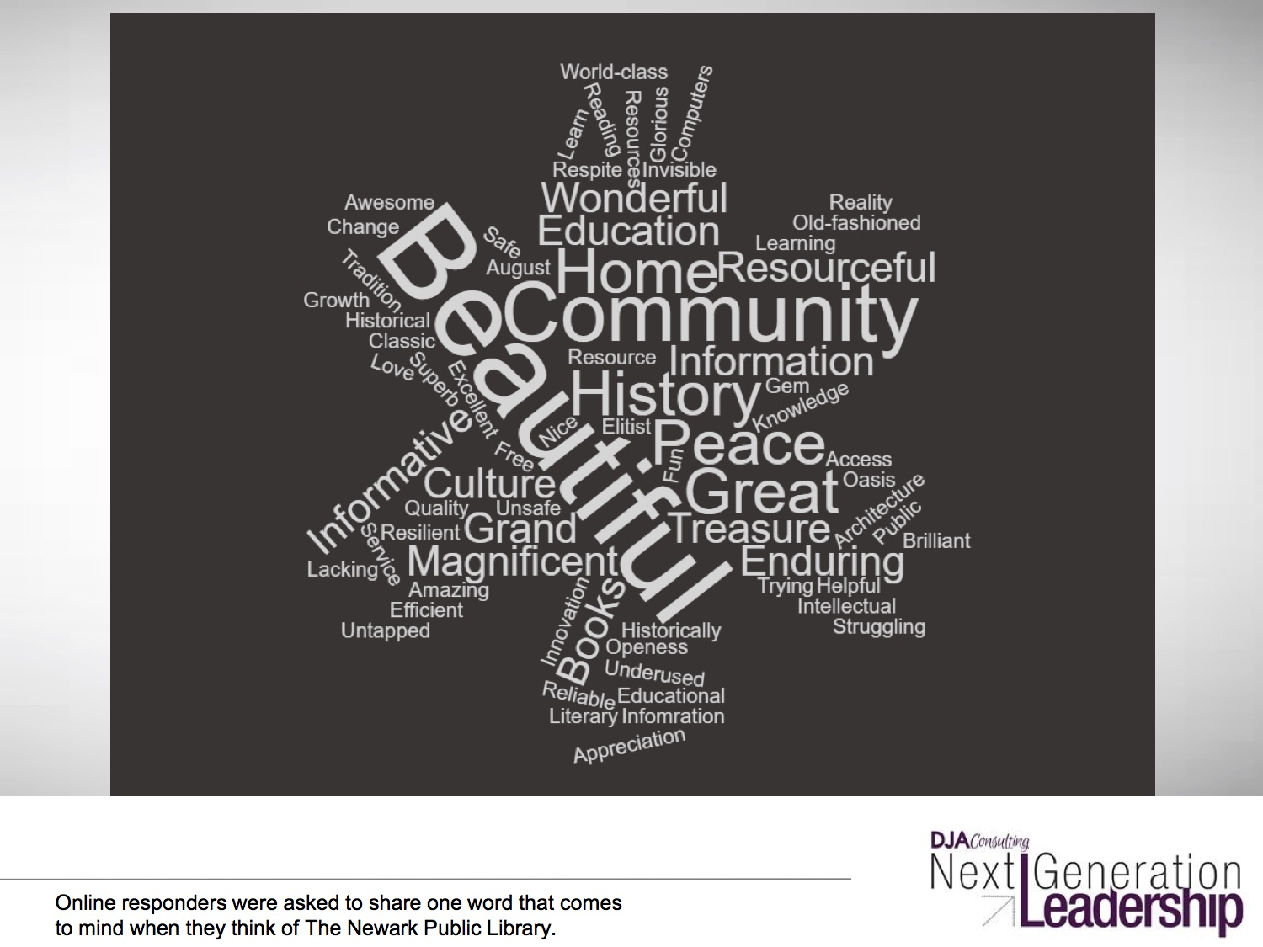
Word Cloud

Slide 13
Priorities
^{Build community}
Address social needs with supportive services
Respond to specific community wants and needs
Increase the library’s visibility and impact
Provide leadership for a Newark’s future
Notes:
^{Build community}
Community members value Newark’s past, present and future. Community members acknowledge Newark’s challenges.
NPL is seen as a safe and secure place for the community.
NPL can address community challenges.
Address social needs with supportive services
Strengthen supportive services for children and youth. Strengthen supportive services across the generations. Provide the community with necessary life skills.
Respond to specific community wants and needs
NPL has demonstrated value to the community.
NPL can leverage its strengths.
NPL can make improvements to satisfy community wants and needs.
Increase the library’s visibility and impact
Address the challenge to change perceptions. Enhance outreach, marketing and promotion.
Provide leadership for a Newark’s future
Create more impactful collaborations and partnerships. Facilitate organizational and culture change.

Slide 14
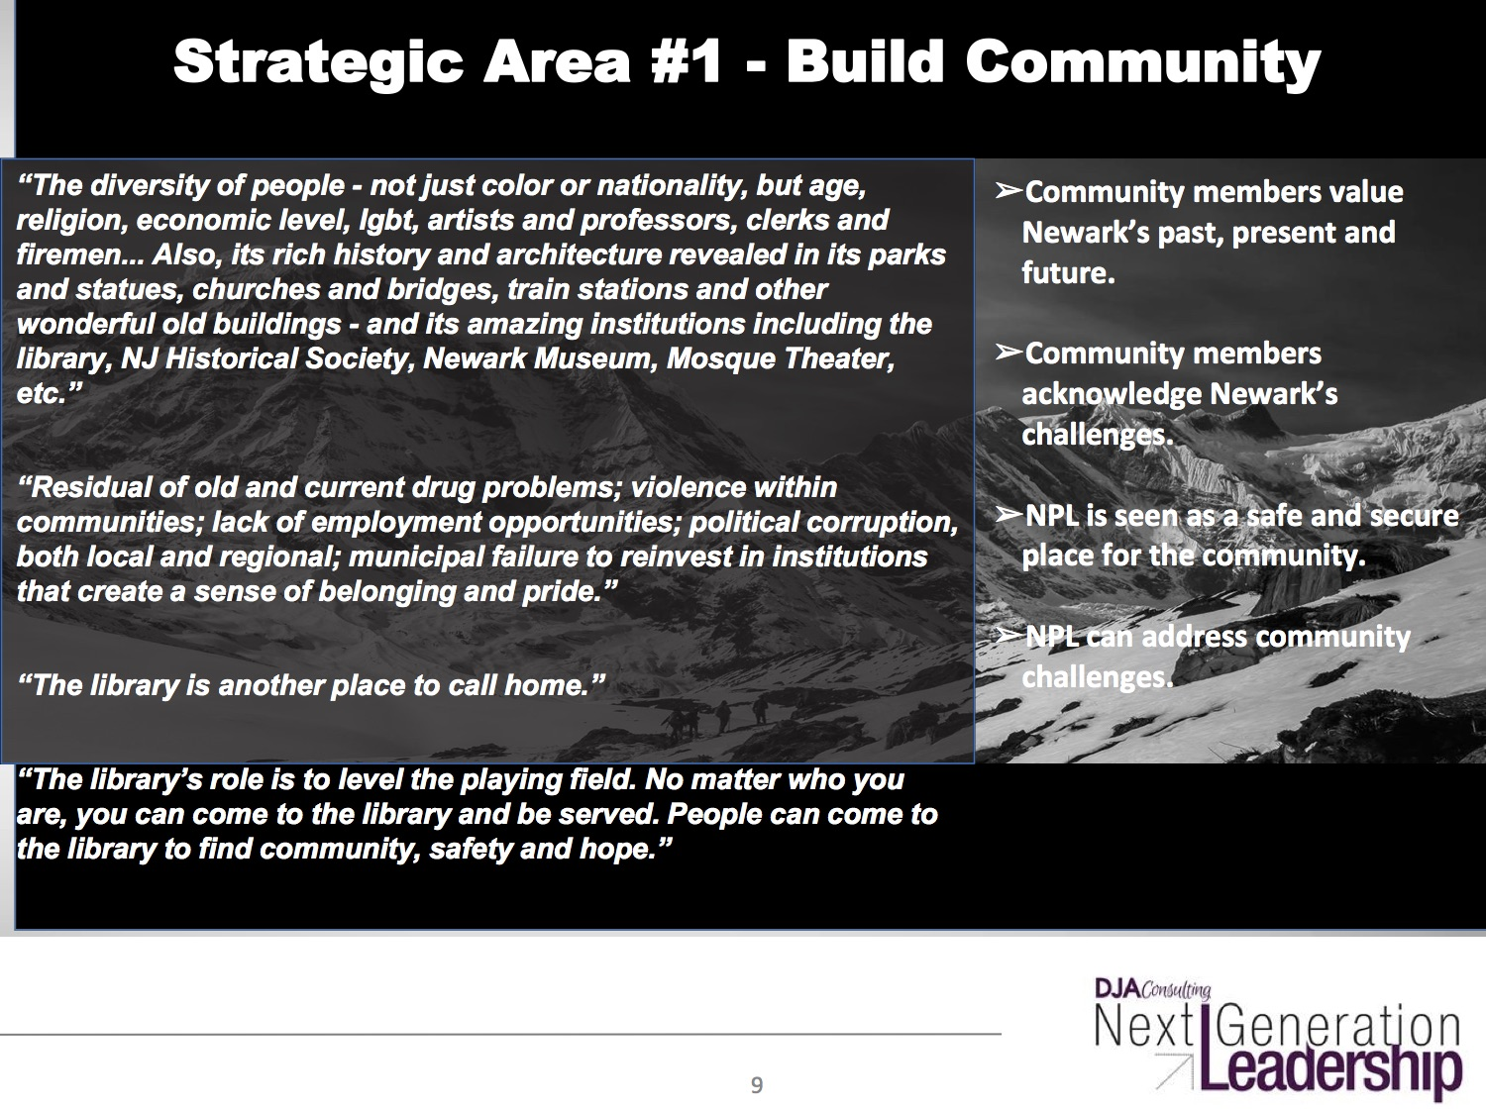

Slide 15
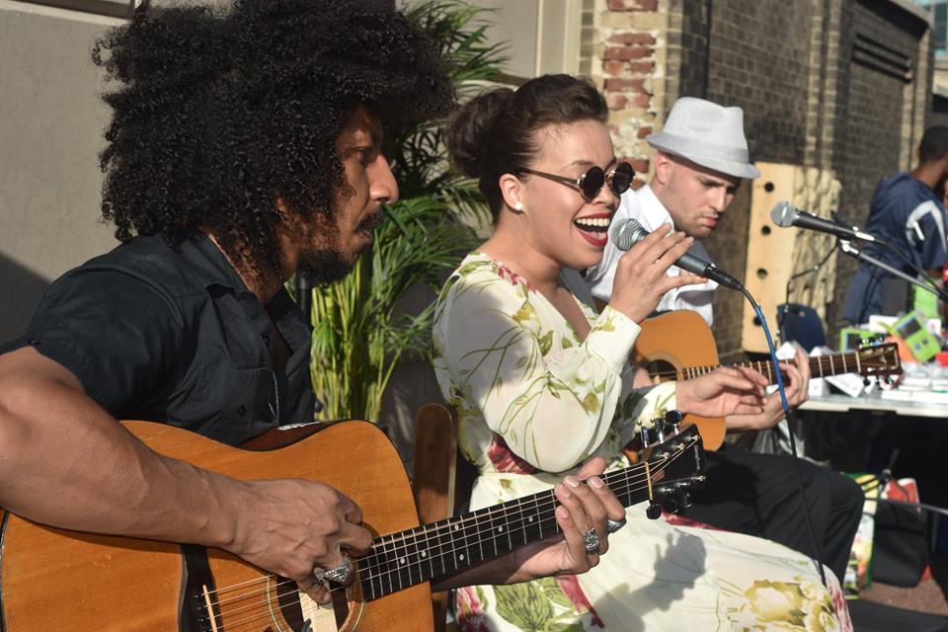
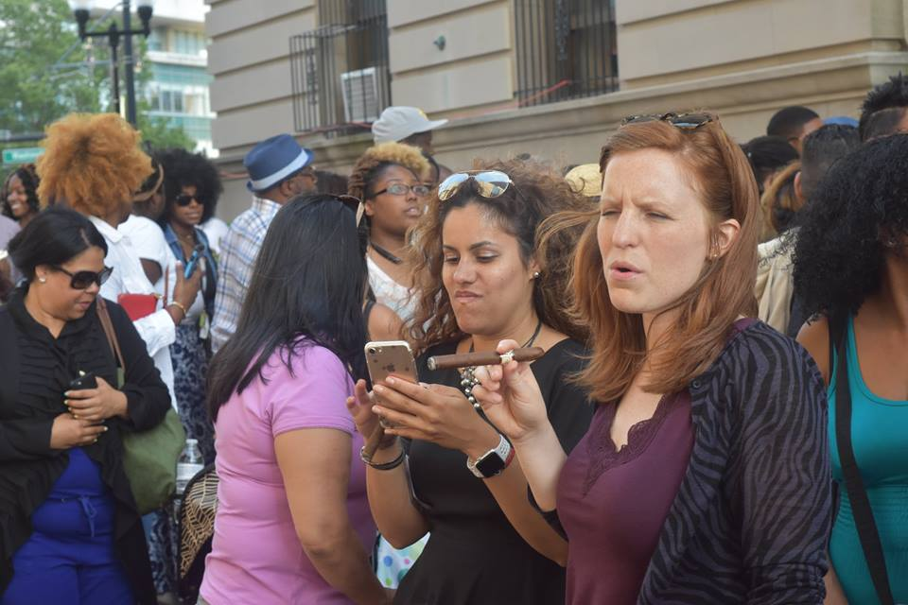
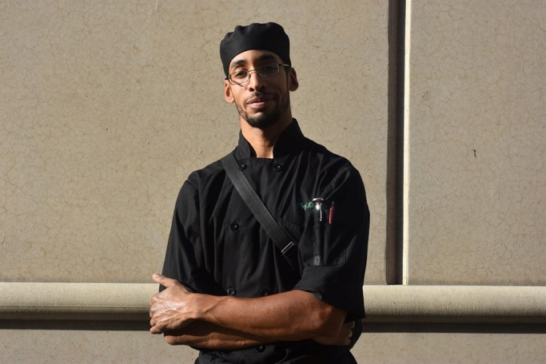
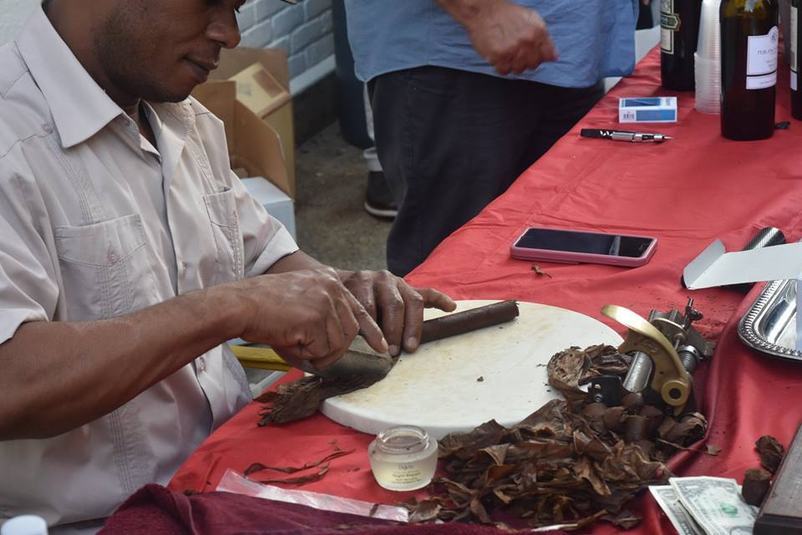
Hot Cuban Night

Slide 16
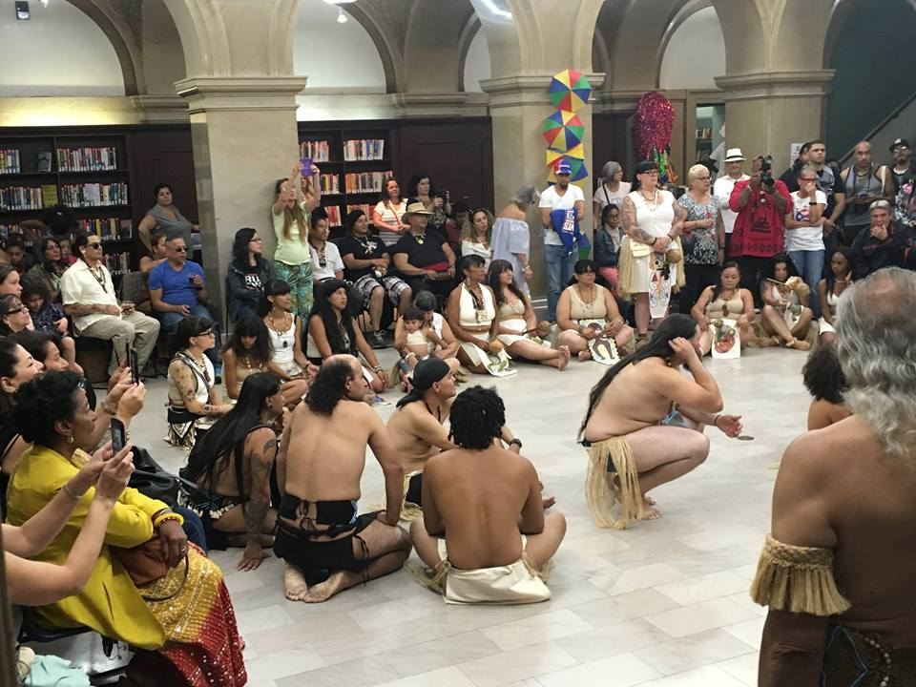
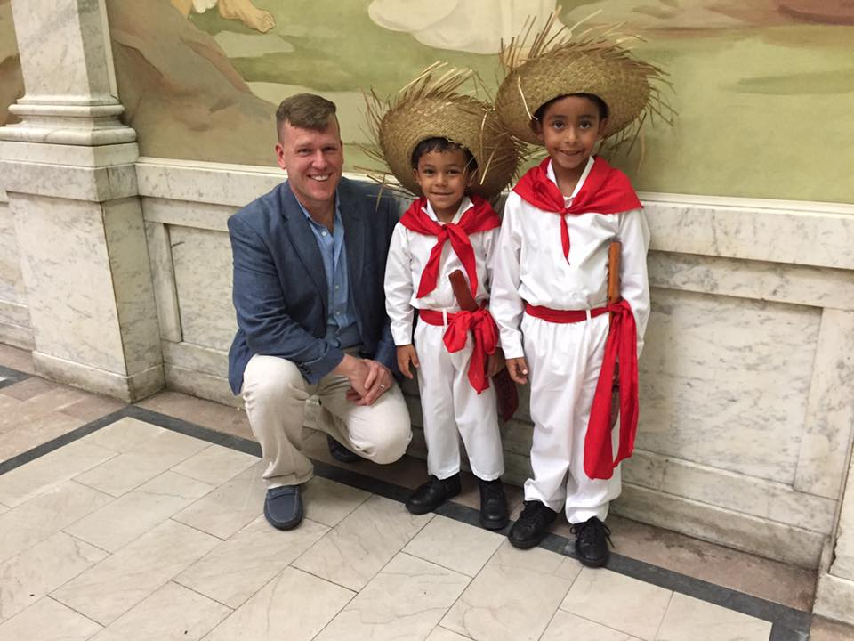
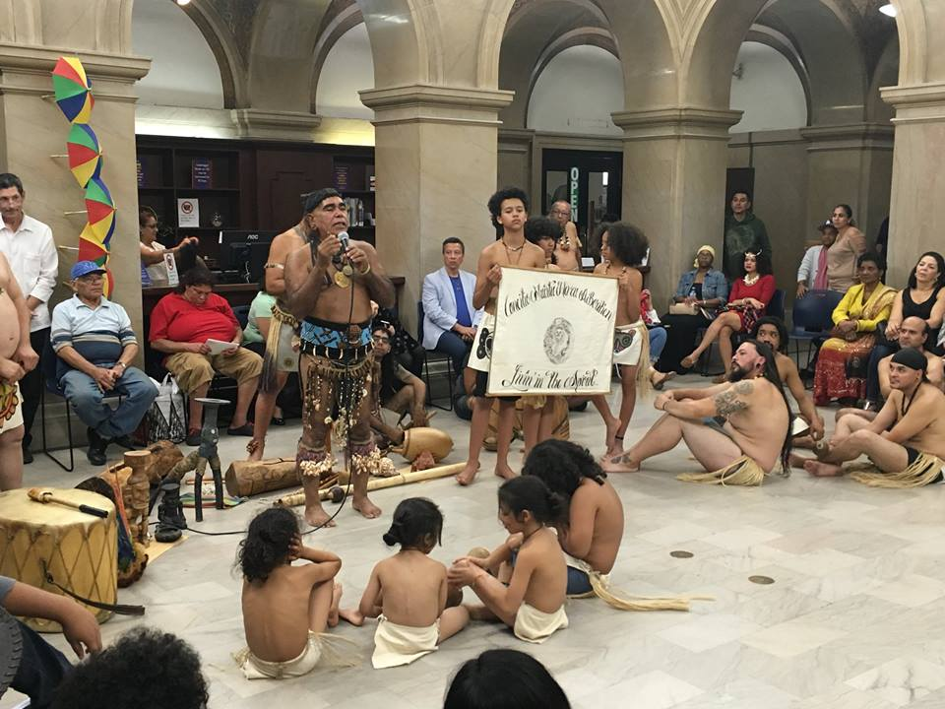
Puerto Rican Day Parade

Slide 17
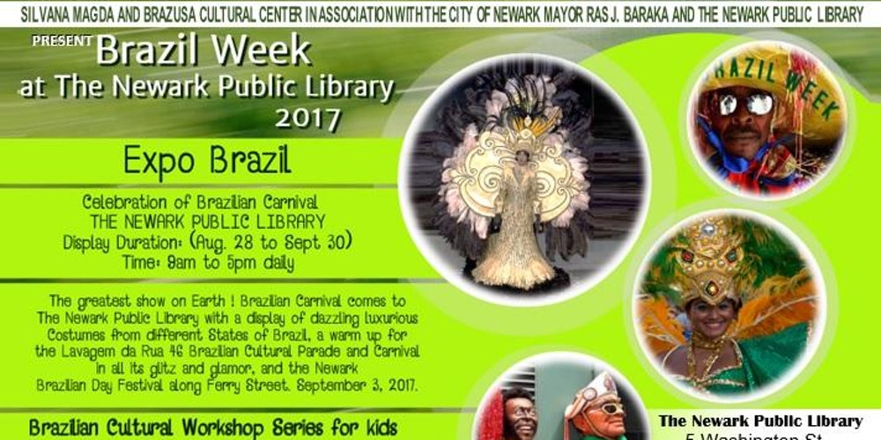
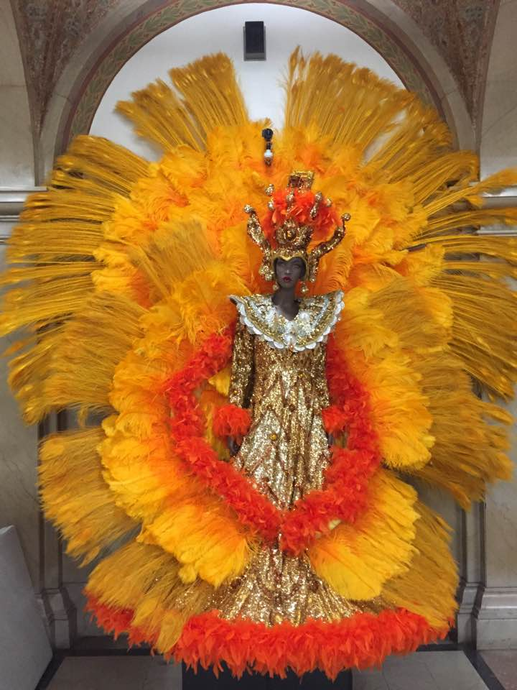
Brazilian Day Parade

Slide 18
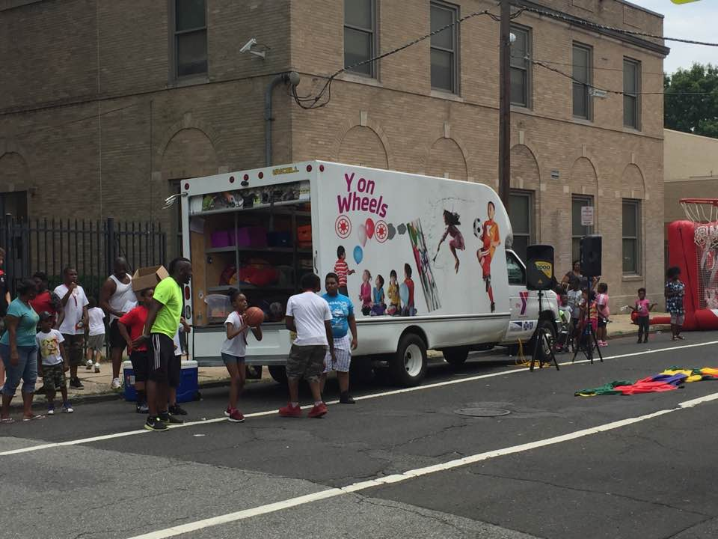
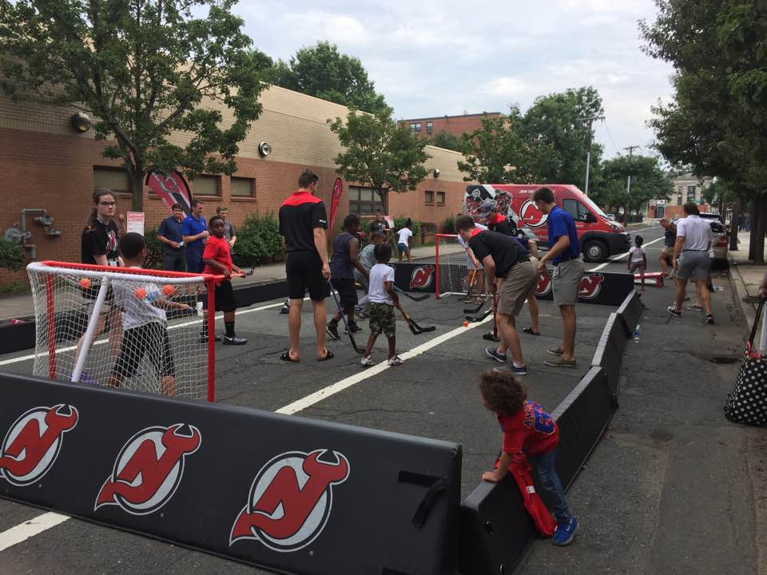
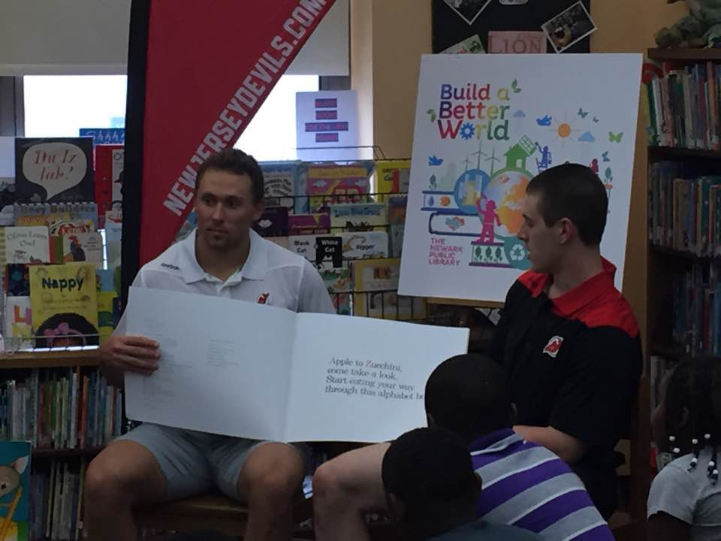
New Jersey Devils (Hockey)

Slide 19
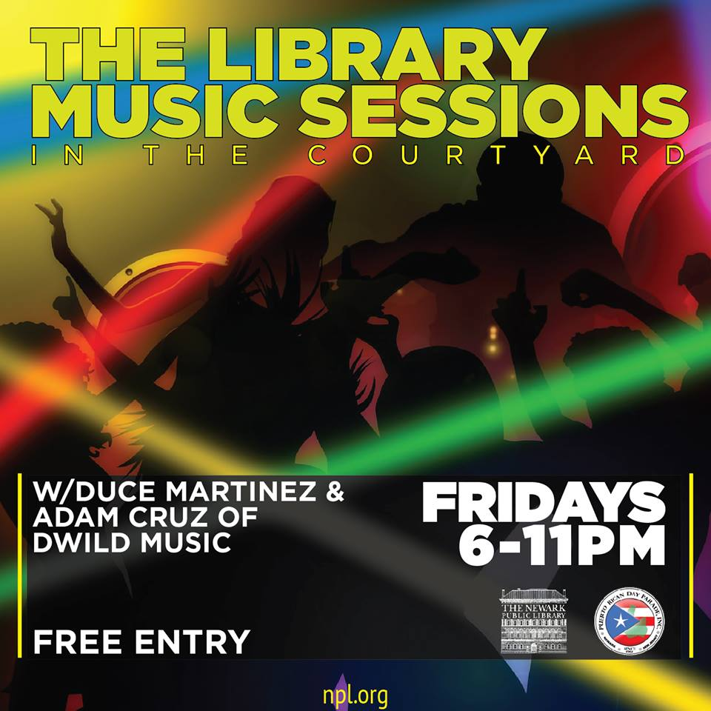
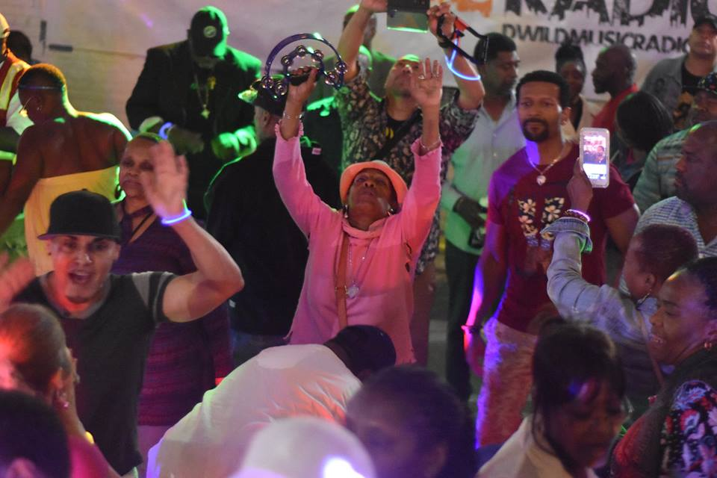
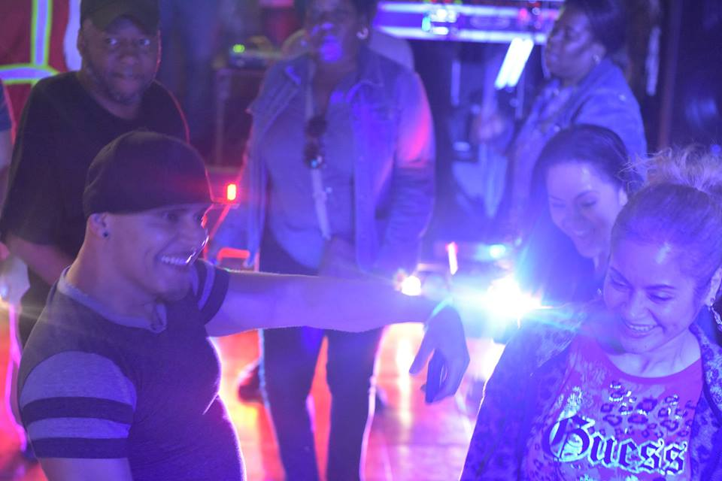
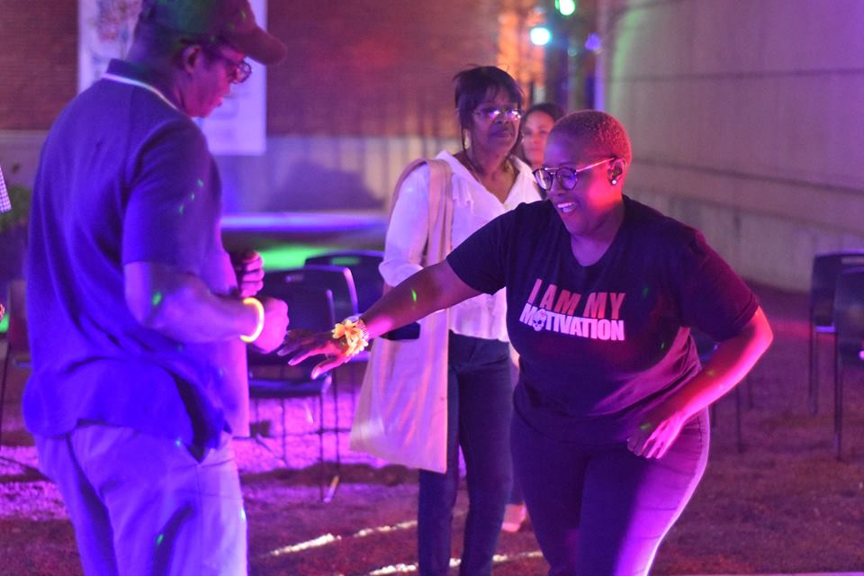

The Library Music Sessions

Slide 20
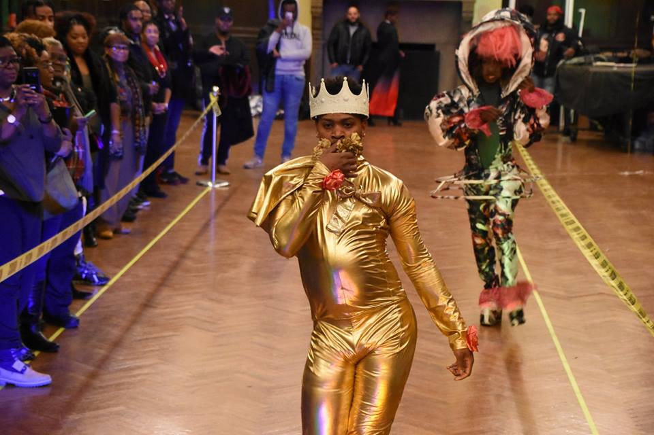
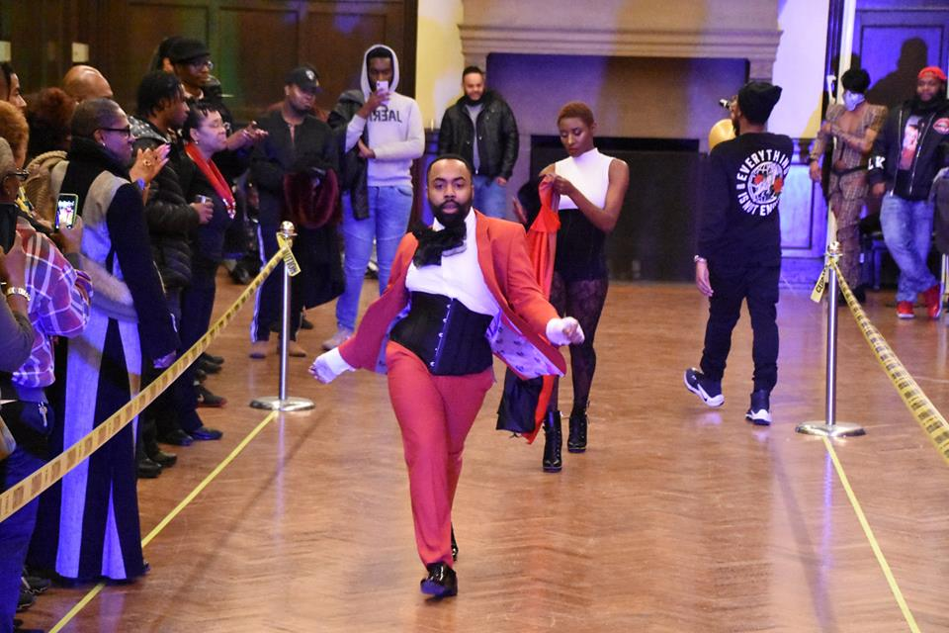
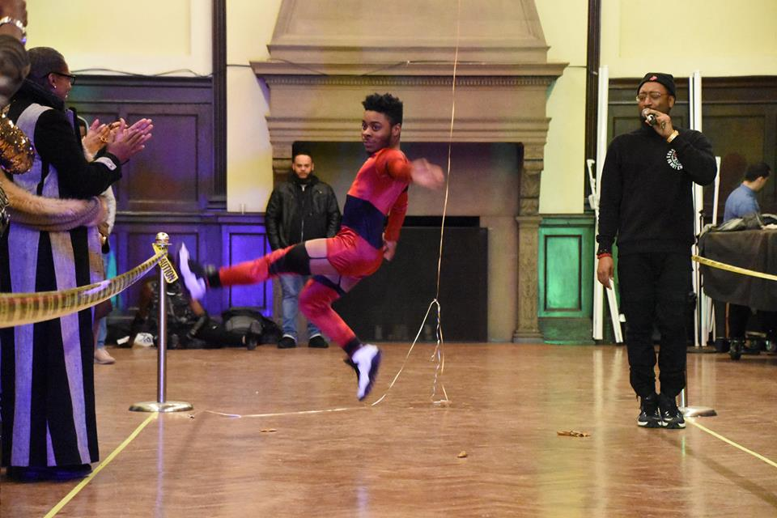
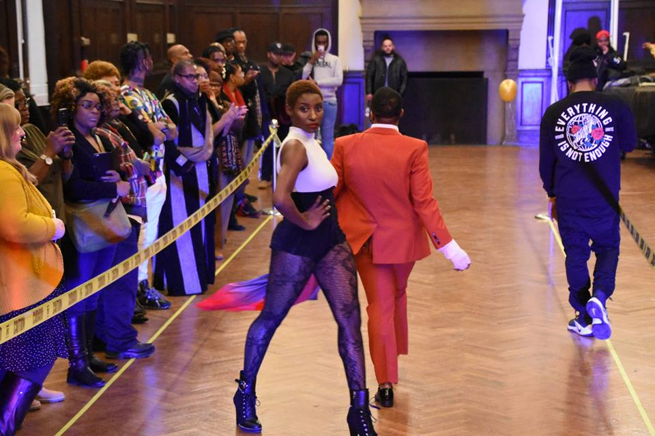
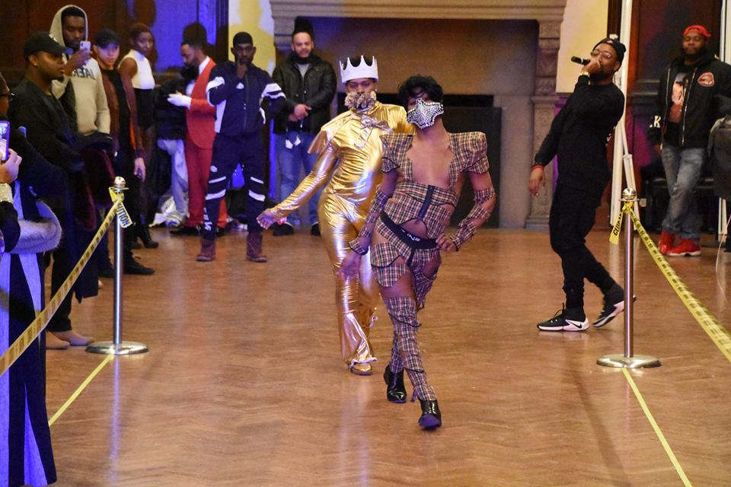

Queer Newark Kiki ball

Slide 21

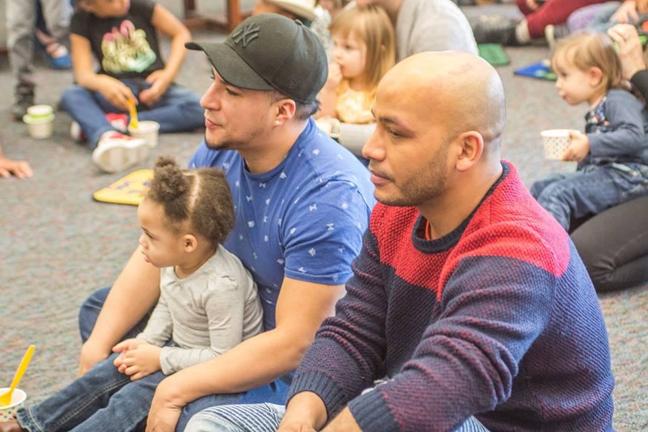
Drag Queen Story Time

Slide 22
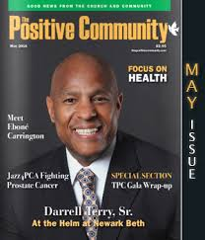
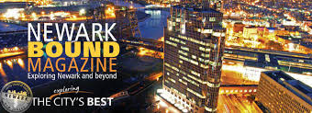
Community Visibility

Slide 23
Impact (Stats)
Main Library Branches
Reference +0.6% +0.4%
Computer Use +2.6% +16.7%
Attendance at Library Programs +148.2% +36.8%
Patron Visits +8.6% +12.4%
Circulation +7.9% +4.8%

Slide 24
Bertrand Russell
“Do not fear to be eccentric in opinion, for every opinion now accepted was once eccentric.”

